Slide 1


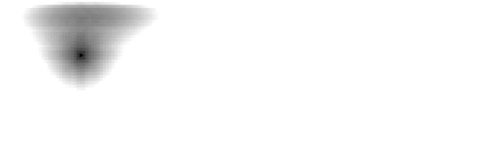
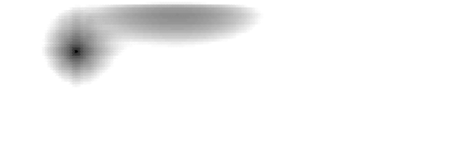

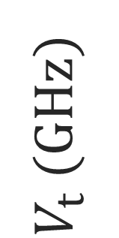

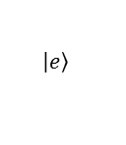
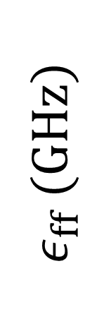
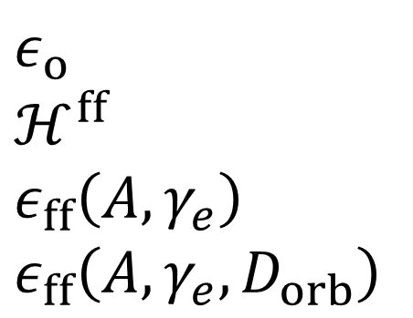
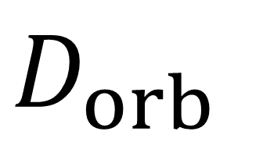
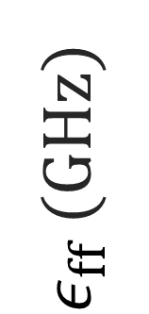
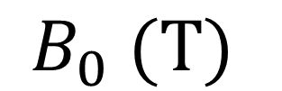
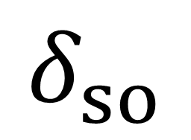
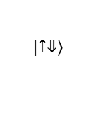
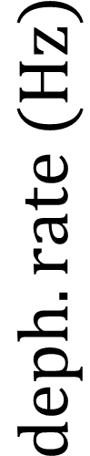
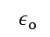
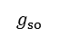

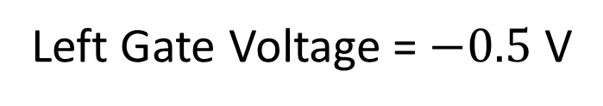
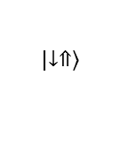
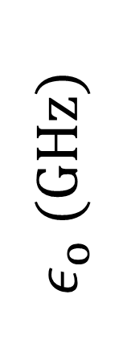
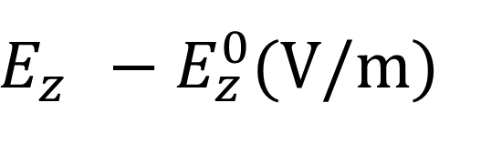
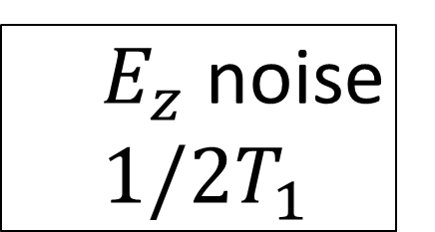
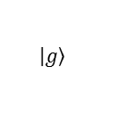
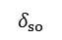
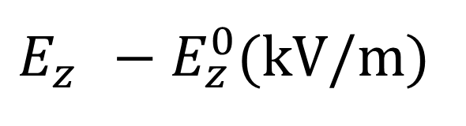
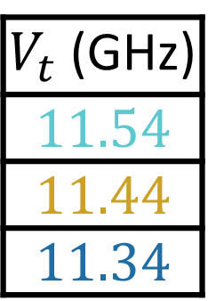

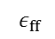
13
12
CQSS
$$≈$$
$$≈$$
$$δ_{so}$$
$$\left|\left.↑⇓\right\rangle \right.$$
$$\left|\left.e\right\rangle \right.$$
$$ε_{ff}$$
$$δ_{so}$$
$$ε_{o}$$
$$g_{so}$$
$$\left|\left.g\right\rangle \right.$$
$$\left|\left.↓⇑\right\rangle \right.$$
11.20
a
b
2nd order CT
$ε_{o}$ (GHz)
$V_{t}$ (GHz)
2nd order CT
$$D_{orb}$$
1st order CT
11.194
c
11.193
2nd order CT
$V_{t}$ (GHz)
$$11.54$$
$$11.44$$
$$11.34$$
11.192
$ε_{o}$
$ℋ^{ff}$
$ε_{ff}\left(A,γ_{e}\right)$
$ε_{ff}\left(A,γ_{e},D_{orb}\right)$
11.191
$ε_{ff}$ (GHz)
11.19
$ε_{ff}$ (GHz)
1st order CT
d
$V_{t}$ (GHz)
-6
-3
0
3
6
$E_{z}^{}−E_{z}^{0}$(kV/m)
$E_{z}^{}−E_{z}^{0}$(V/m)
e
g
$$deph. rate (Hz)$$
$$deph. rate (Hz)$$
$E_{z}$ noise
$1/2T_{1}$
$E_{z}$ noise
$1/2T_{1}$
100
20 nm
V_{t} (GHz)
$$B_{0} (T)$$
10
$$B_{0} (T)$$
f
1
-1.0
-0.8
-0.6
-0.4
V_{r} (V)
Left Gate Voltage = $−0.5$ V
Al₂O₃
Top
Gate
Al
Left Gate
Right Gate
SiO₂
SiO₂
³¹P
Si
Silicon
30 nm

